Slide 1


A Qualitative Analysis of Online Groups
Nirmal Kumar Sivaraman & Sakthi Balan Muthiah
Department of Computer Science and Engineering
The LNM Institute of Information Technology, Jaipur

Slide 2
Outline of the Talk
Motivation
A Model for Qualitative Analysis of Groups
Examples of Qualitative Analysis of Twitter Groups
Conclusion

Slide 3
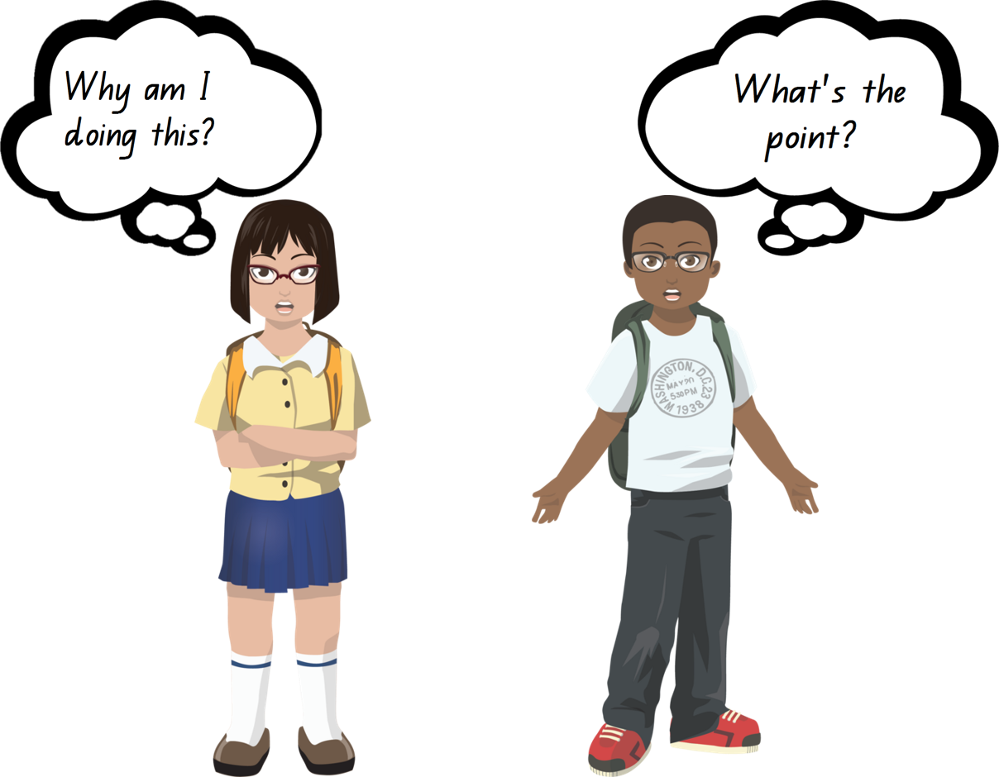
Motivation

Slide 4
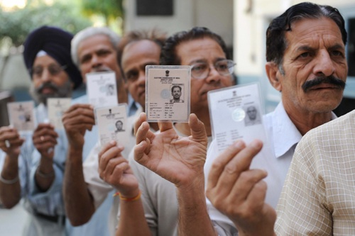
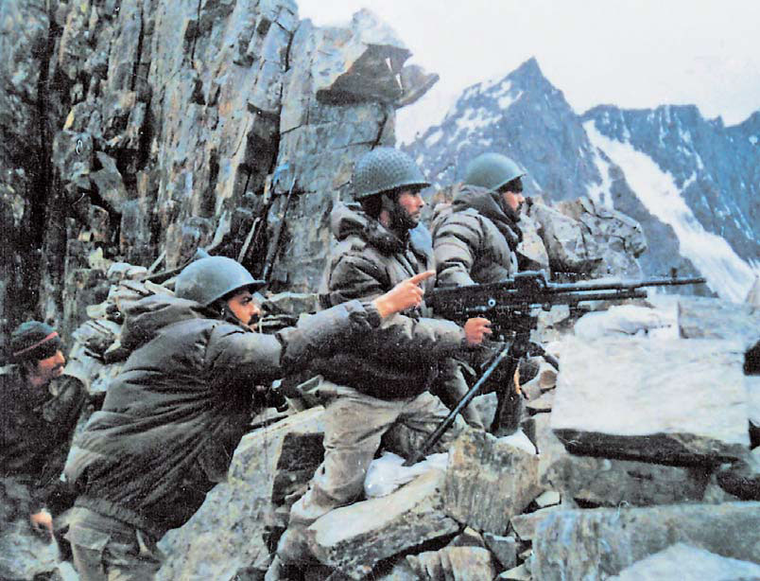
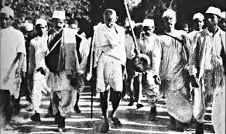
Group dynamics lead to big changes in the society
Freedom movements
Wars
Elections

Slide 5
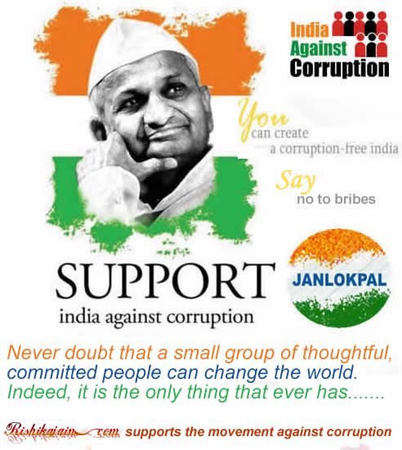
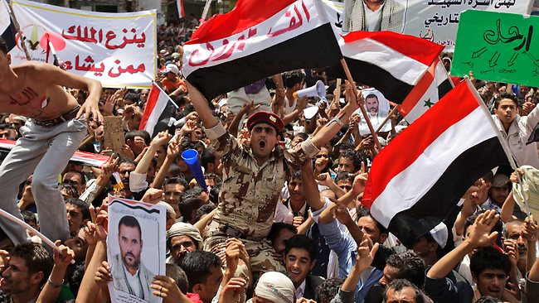
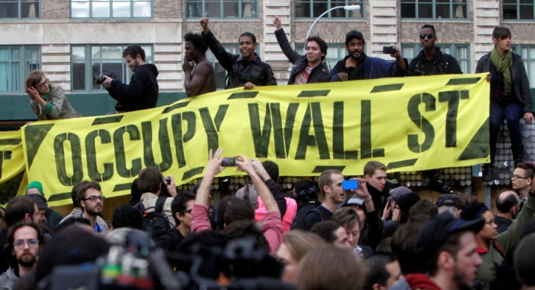

Online group dynamics also impact the society
Arab Spring
India Against Corruption
Occupy Wall Street
Net neutrality

Slide 6



Crowdsourcing Failures
Failed attempt by Reddit to identify the Boston marathon bomber
Low rating of the movie “Gunday” in IMDb

Slide 7
Quality Control Measures
Assessment of the requester’s behavior
Eg: Turkopticon
Generosity
Fairness
Promptness
Communicativity
Assessment of the crowd
Eg: Matching the expertise of the users to the requirement of the job

Slide 8
The Problem
The problem that we are addressing are two–fold.
Understanding groups better by looking at the relevant cognitive phenomena of the members of the groups.
If we encounter a group of people, what can we infer about that group qualitatively?
Qualitatively analyzing online groups in Twitter.
If we encounter a group of online users in Twitter, what can we infer about that group qualitatively?

Slide 9
Qualitative Analysis of Groups

Slide 10
Hypothesis
Human communication comprises of two essential semantic elements: abstraction and expression.
Abstraction refers to objective assertions about the topic or issue in question
Expression refers to communication of our subjective feeling or emotion in that situation. The emotion expressed may or may not be about the topic in question.

Slide 12
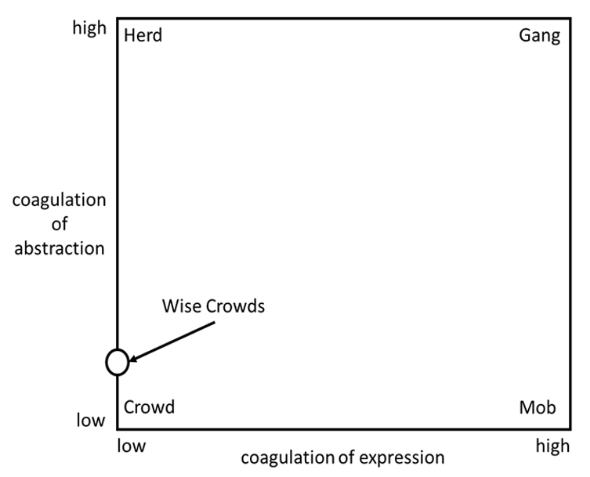

Slide 13
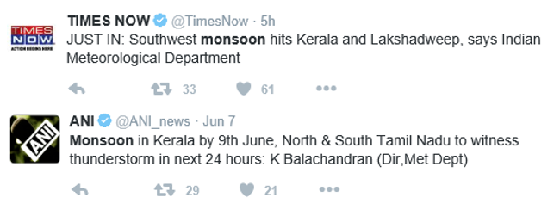
Tweets having similar abstraction

Slide 14
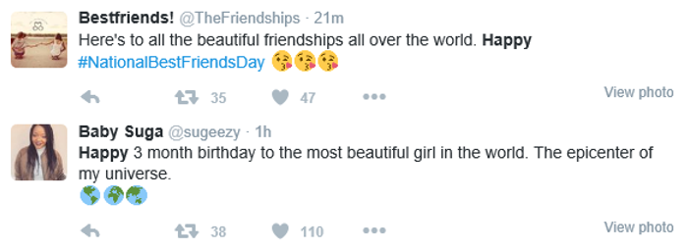
Tweets having similar expression

Slide 16
Estimation of Coagulation of Abstraction
Probability of coagulation of Abstraction, p(a) = P/T
Where P is the number of tweets in the largest polarity cluster
T is the total number of tweets.
We compare the abstraction component by comparing the sentiment score of the texts
We used the Hu-Liu lexicon to identify the sentiment content
The overall score for a tweet would be negative, neutral or positive

Slide 17
Estimation of Coagulation of Expressions
Probability of coagulation of Expression, p(e) = E/T
Where E is the number of tweets in the largest emotion cluster
T is the total number of tweets
We compare the expression component by comparing the emotion score of the texts
We used the Hu-Liu lexicon to identify the emotion content
The overall score for a tweet would be the six basic emotions - anger, disgust, fear, joy, sadness and surprise

Slide 18
Crowd, Herd, Mob and Gang Probability Scores
p(herd) = p(a)(1 - p(e))
p(mob) = (1 - p(a))p(e)
p(crowd) = (1 - p(a))(1 - p(e))
p(gang) = p(a)p(e)

Slide 19
Examples of Qualitative Analysis
Brexit
Black Money

Slide 20
Brexit Dataset
Topic : #Brexit
Starting date : 18-06-2016
Ending date : 27-06-2016
Total Number of Tweets : 18,79,707
Total Number of Users : 9,25,358

Slide 21
Brexit Dataset

Slide 22
Black Money Dataset
Topic : #BlackMoney
Starting date : 05-11-2016
Ending date : 22-11-2016
Total Number of Tweets : 2,57,113
Total Number of Users : 1,10,719

Slide 23
Black Money Dataset

Slide 24
p(a) and p(e) plot for Brexit Dataset

Slide 25
p(a) and p(e) plot for Black Money Dataset

Slide 26
Crowd, Herd, Mob and Gang probabilities for Brexit Dataset

Slide 27
Crowd, Herd, Mob and Gang probabilities for Black Money Dataset

Slide 28
Conclusion
The group dynamics – both offline and online – can be very important impacting the society at large.
It is easy to analyze the online groups because of the availability of the content of communication.
There are fundamental cognitive parameters that we can look into to understand more about the groups qualitatively.
There is huge scope for exploration in this direction.

Slide 29
Thank you!
Questions and comments are highly appreciated!

